Slide 1



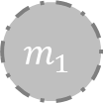


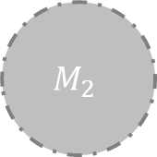
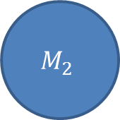

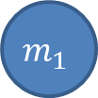




$$k$$
$$M_{2}$$
$$M_{2}$$
$$m_{1}$$
$$m_{1}$$
$$x$$
$$Δx_{1}$$
$$ℓ_{0}$$
$$Δx_{2}$$
$$x_{1}^{}$$
$$x_{1}^{(0)}$$
$$x_{2}^{(0)}$$
$$x_{2}^{}$$

Slide 2







$$−\frac{ℓ_{0}}{2}$$
$$\frac{ℓ_{0}}{2}$$
$$0$$
$$\hat{x}$$
$$−\frac{ℓ_{0}}{2}−Δx$$
$$Δx$$
$$\frac{ℓ_{0}}{2}−Δx$$
neutral plasma
e⁻
ion

Slide 3






$$−\frac{ℓ_{0}}{2}$$
$$\frac{ℓ_{0}}{2}$$
$$0$$
$$\hat{x}$$
$$Δx_{e}$$
$$Δx_{i}$$
neutral plasma
e⁻
ion

